Slide 1
Measuring Heart Rate from
ECG(Electro-cardiogram) Data
By Detection of R-peaks Methods

Slide 2
Content
How ECG is recorded?
Why the ECG occurs?
Detecting R-peaks and measuring the heart rate of a person using MATLAB.

Slide 3
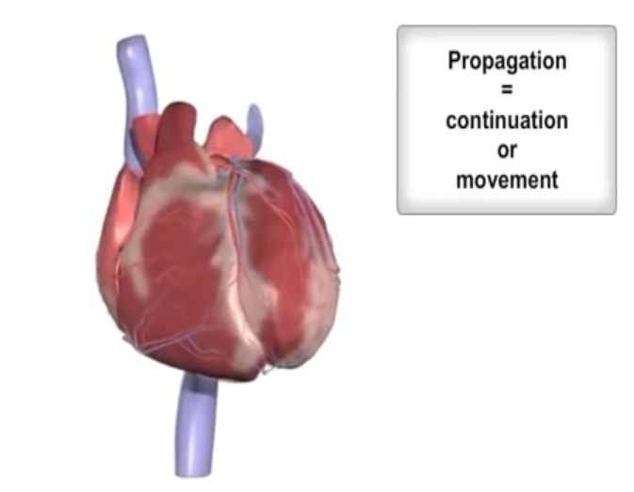
ECG Introduction
The heart muscles contract and expand to generate signals that is recorded as ECG
ECG is the measured electrical activity of the heart

Slide 4
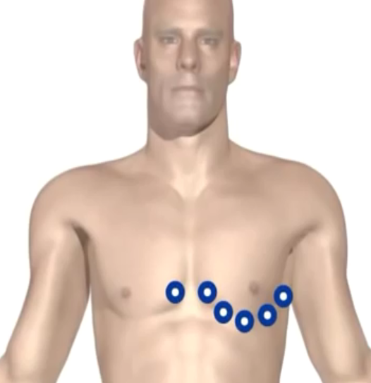
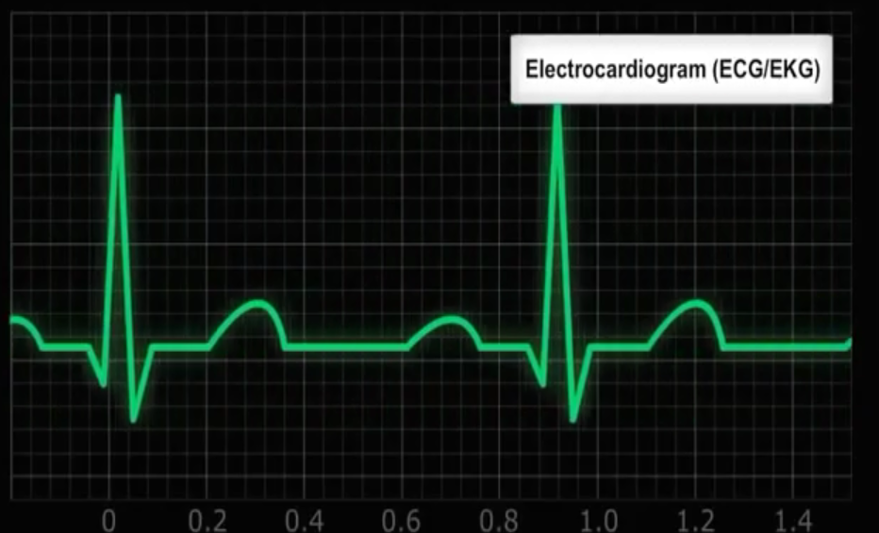
ECG Introduction
This electrical activity and be measured by placing electrodes at specific points on the skin

Slide 5
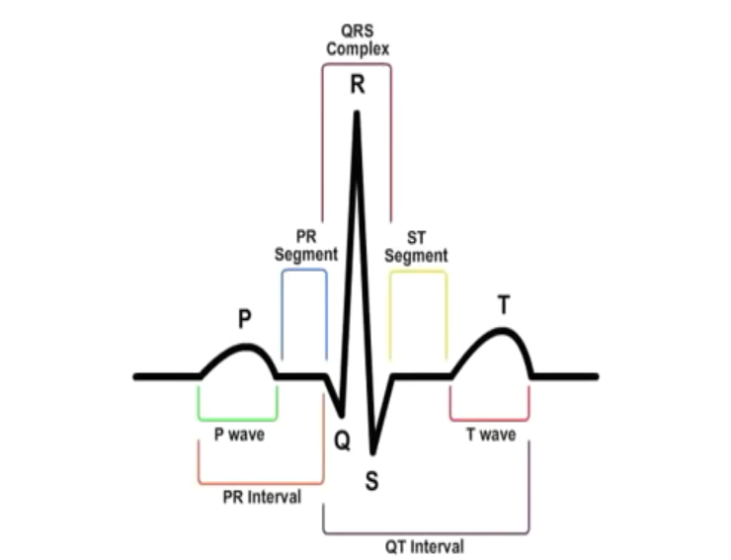
ECG Introduction
An Ideal ECG looks like this, and it keeps repeating itself
We will try to detect the R-peaks in this presentation.

Slide 6
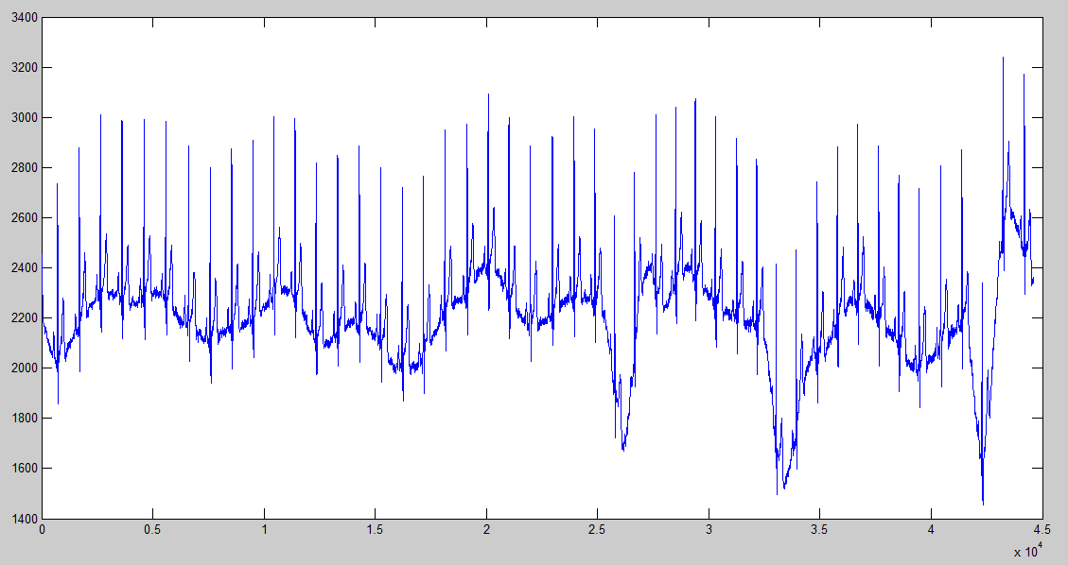
R-peaks detection in MATLAB
The source ECG signal data
That we’ll perform Analysis on, to find out the HeartRate

Slide 7
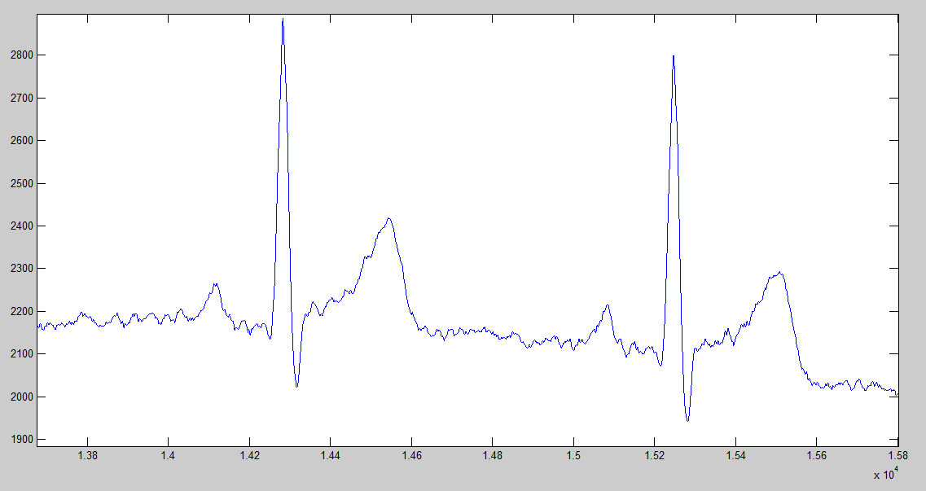
R-peaks detection in MATLAB
An Up-close view of the Source ECG signal data

Slide 8
Steps for Detection
Remove low frequency components
Change to frequency domain using FFT
Remove low frequency components
Back to time domain using IFFT
Find local maxima using windowed filter
Remove small values, store significant ones
Adjust filter size and repeat 2,3

Slide 9
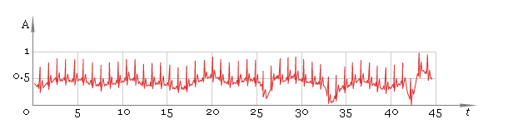
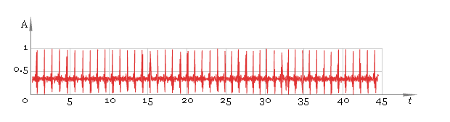
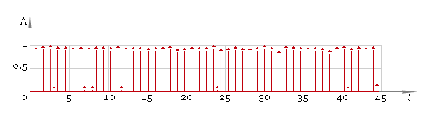
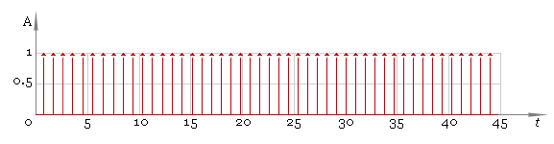
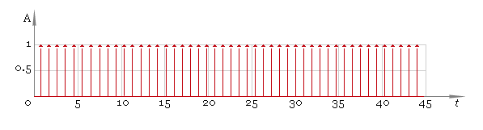
Input
After removing low frequency components
Using a windowing filter
Thresholding
Using the adjusted filter

Slide 10
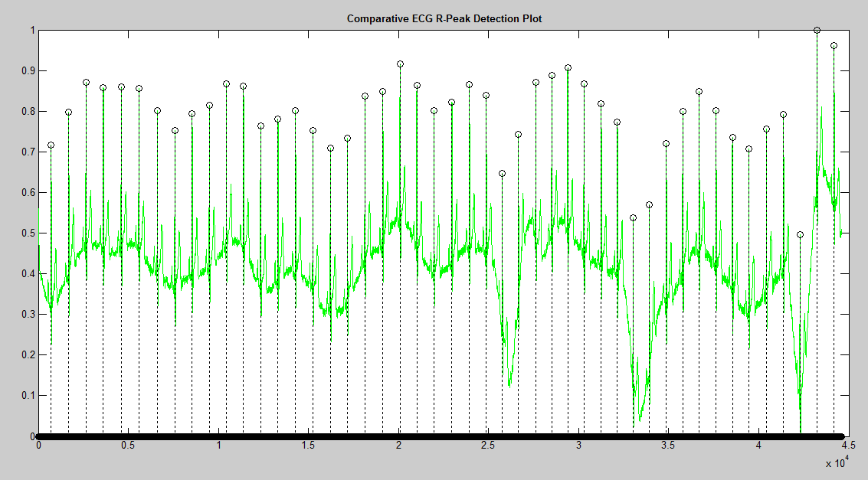
Final result of Algorithm

Slide 11
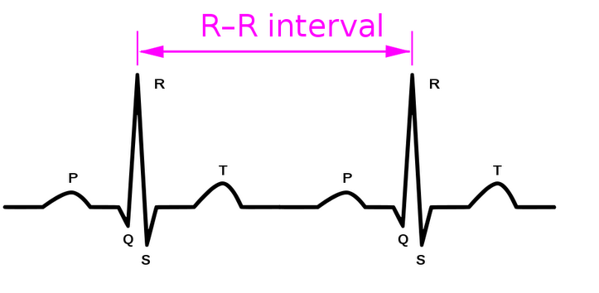
Calculating heartbeat
This is my contribution to the code
Heartbeat Rate in (beats/second) can be calculated by the formula
Rate= 60*sampling rate/(R-R interval)

Slide 12
Thanks!

